Slide 1
Materials Manufacturing (EDPT 601)
Tutorial 7
Machining
By: Eng. Olivia Nashaat

Slide 2
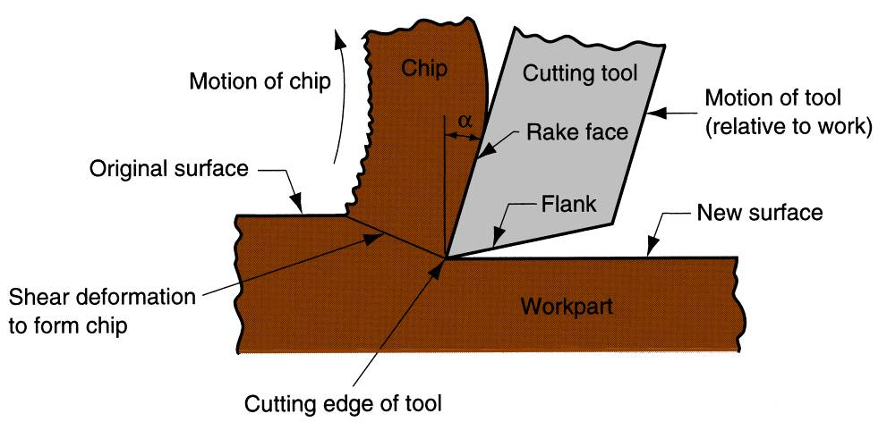
Machining
Machining is a material removal process in which a sharp cutting tool is used to mechanically cut away material so that the desired part geometry remains.
Cutting action involves shear deformation of work material to form a chip.
A cross‑sectional view of the machining process

Slide 3
Machining Operations
Most important machining operations:
Turning
Drilling
Milling

Slide 4
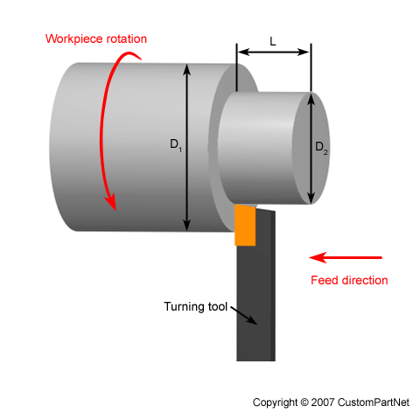
Turning
Turning is the process of machining cylindrical and conical surfaces
It is usually performed on a lathe where the workpiece is rotated into a longitudinally fed, single point cutting tool.

Slide 5
Other important turning operations include:
Facing
Parting (cutting off)
Threading
Grooving
Taper turning
Chamfering
Form turning (profiling)
Knurling
Drilling

Slide 6
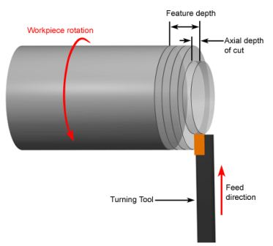
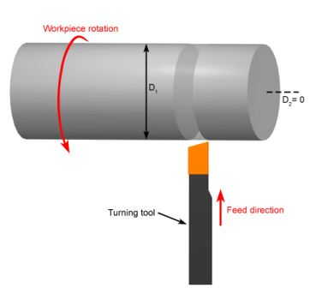
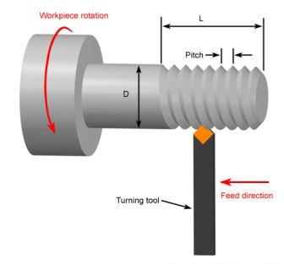
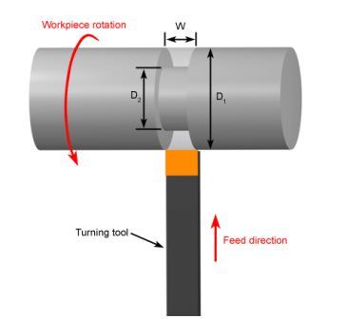
Facing | Parting (Cut Off)
Threading | External Grooving

Slide 7
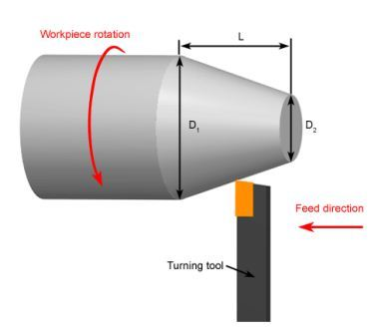
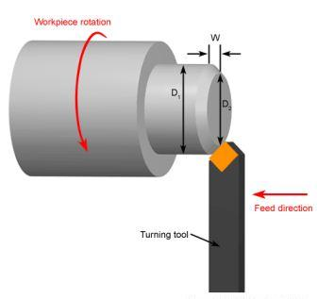
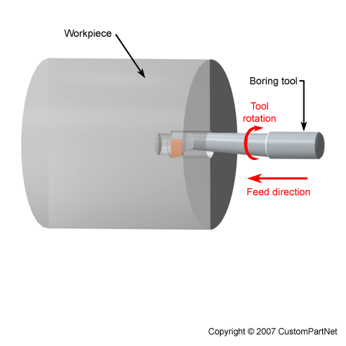
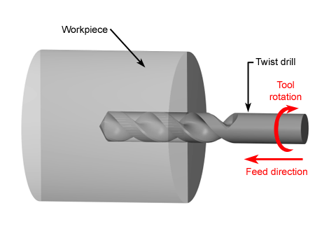
Taper Turning | Chamfering
Boring and Internal Grooving | Drilling

Slide 8
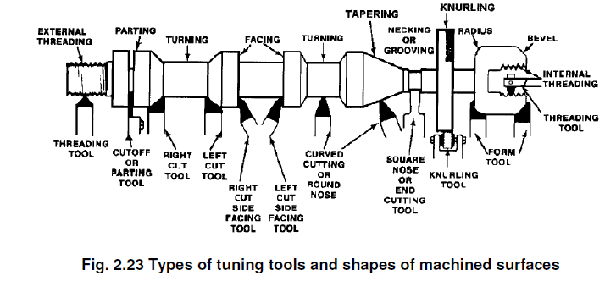
Common Turing tools

Slide 9
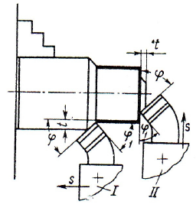
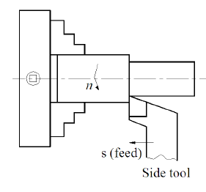
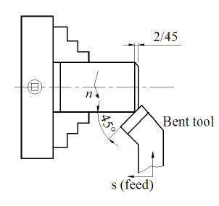
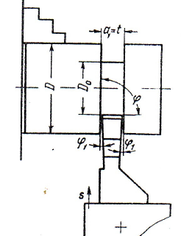
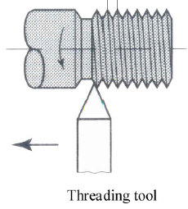
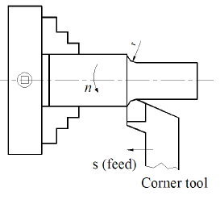
Facing Side turning Chamfering
(RH/LH facing tool or bent tool) (RH or LH side tool) (Bent tool )
Cornering parting off Threading
(corner tool) (Cut-off tool) (Threading tool)

Slide 10
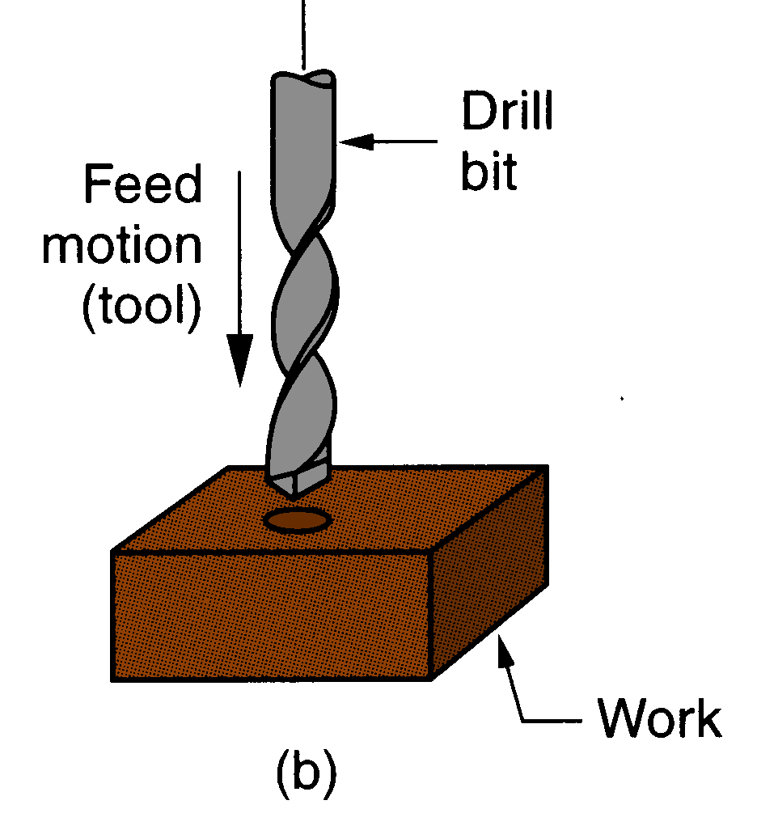
Drilling
Drilling creates a round hole in a workpiece
It is performed on a drill press using a drill/drill bit.

Slide 11
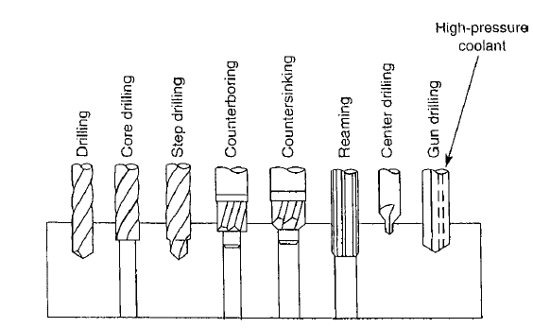
Operations that can be performed on a drill press are:
Drilling
Core drilling
Step drilling
Counter-boring
Counter-sinking
Reaming
Center drilling
Gun drilling

Slide 12
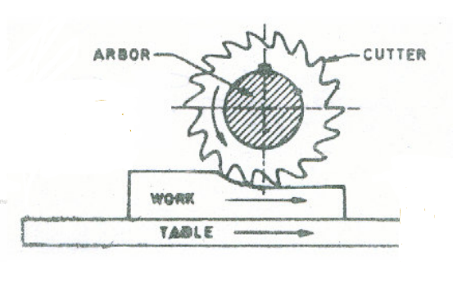
Milling
Milling is the process of machining flat, curved or irregular surfaces by feeding the workpiece against a rotating cutter containing a number of cutting edges.

Slide 13
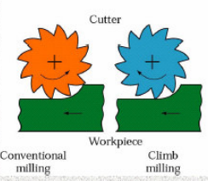
Conventional and climb milling
Conventional milling is the common type of milling. There may be a tendency for the tool to chatter and the workpiece to be pulled upward, necessitating proper clamping. It is also called slab/up milling.
In climb milling, also called down milling, the downward component of the cutting forces holds the workpiece in place.

Slide 14
Milling Operations
Milling operations include:
Slab milling
Face milling
End milling
Straddle milling
Form milling
Slitting
Slotting

Slide 15
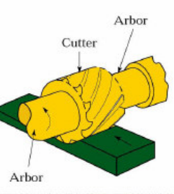
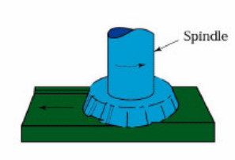
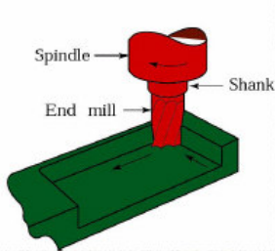
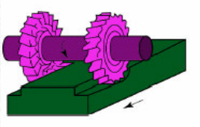
Slab milling | Face milling
End milling | Straddle Milling

Slide 16
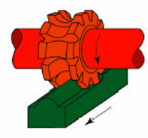
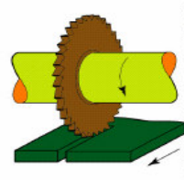
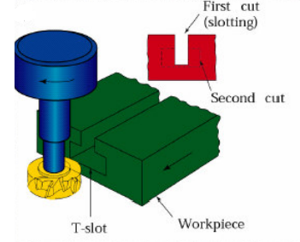
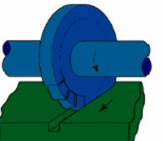
Form milling | Slitting
Slotting | T-slot Cutting

